Slide 1
Pwn 0x01
Author：张嘉熙

Slide 2

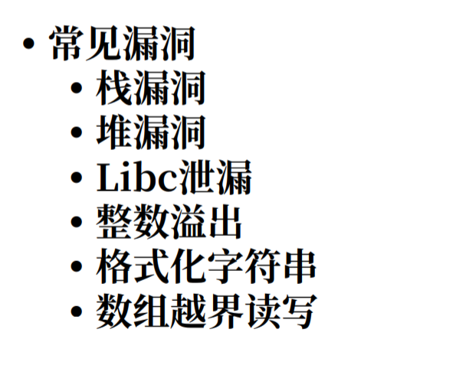
What is Pwn
Pwn is a sound refer to a machine is hacked. Just like...
For us: A program with bugs is given->
  find the vulnerability
  make it useful
  Do whatever you want ,read some msg, or even rm -rf */

Slide 3
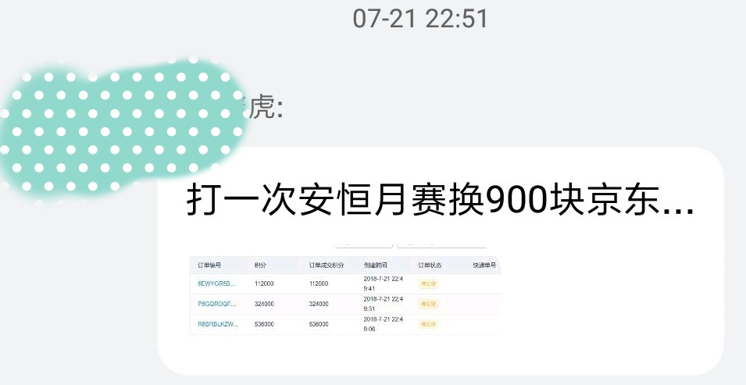
Why we pwn
For competition
To pracitice your skill to find bugs.
  ——The vulnerabilities is always there.
To make money
  Great rewards for submitting bus
  Don't as what the Criminal code says.

Slide 4
How to pwn
Control the program flow without changing the program
Leak some imformation in memory
Change the flow of the program and get the control of a Server.

Slide 5


Some Pre-knowledge
Simple assembly language (x86, x64)
gdb, IDA, even R2
Compiling principle.

Slide 6
Simple assembly & gdb
call func1
push eax
pop edi
jmp, je, jne
mov eax, 0xffffffff
add, sub, mul...
eip :next instruction
esp :top of stack
ebp :base of stack
gdb ./filename
disas funcname
b * 0x8048f5b
r
c
n (F10)
s (f11, enter the func)
x (/$$$) 0x804a040
  ->telescope 0x123456 20
set disassembly-flavor intel

Slide 7
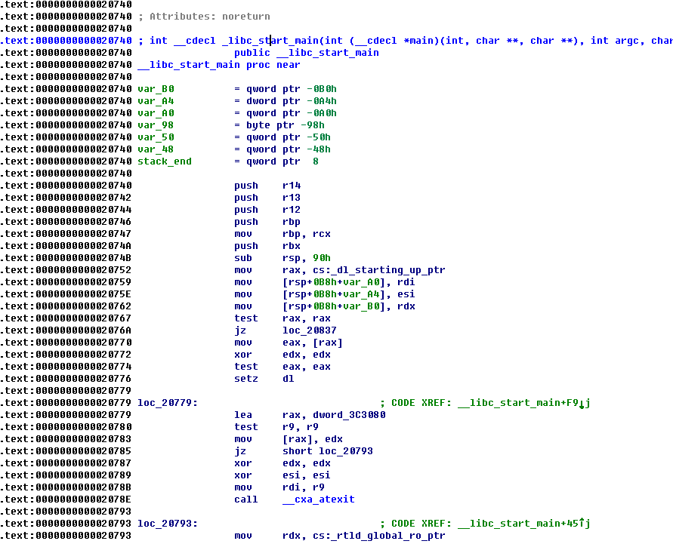
What is in the program
.got -> have something to do with the address of vars in menory
.plt -> where to find the address of functions
.plt.got -> store the real address of functions in menory
.text -> code // readable, executable but forbidden to write
.data -> store the initeddata which work in the whole program
.bss -> store the unInited data that works in the whole program
.extern -> some key vars when linked to libc

Slide 8
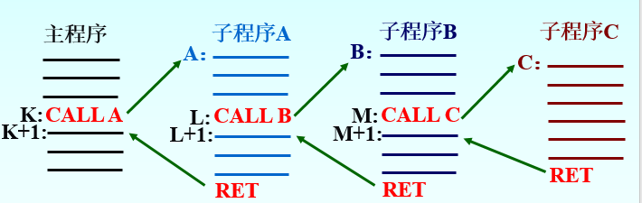
How the function is called?
How to transfer argvs?

Slide 9
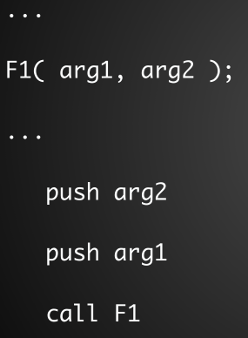
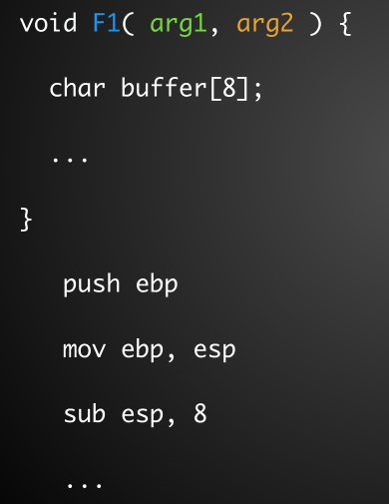
如果在函数A中调用了函数B，我们称函数A为主调函数，函数B为被调函数，如果函数B的声明为int B(int arg1, int arg2, int arg3)，那么函数A中的调用函数B时的汇编指令的形式如下：
push arg3
push arg2
push arg1
call B
连续三个push将函数的参数按照从右往左的顺序进行压栈，然后执行call B来调用函数B。注意在gdb中看到的效果可能不是三个push，而是三个mov来对栈进行操作，这是因为Linux采用AT&T风格的汇编，而上面的指令使用的是Intel风格的汇编，比较容易理解。

Slide 10
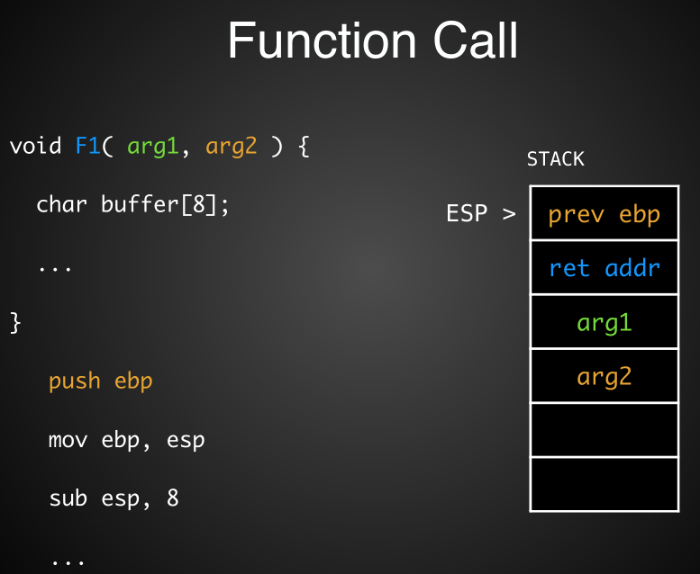
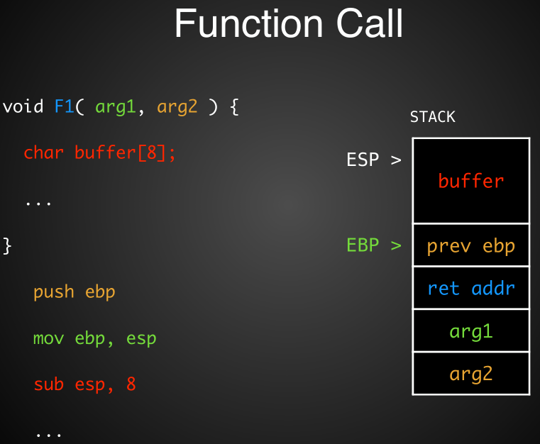
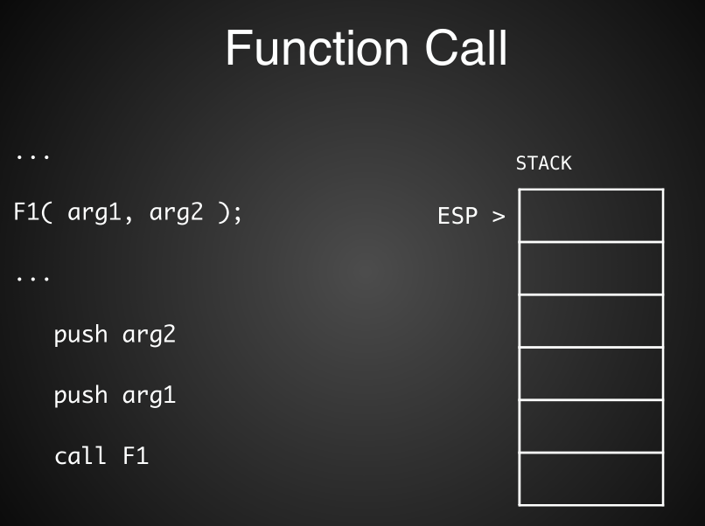
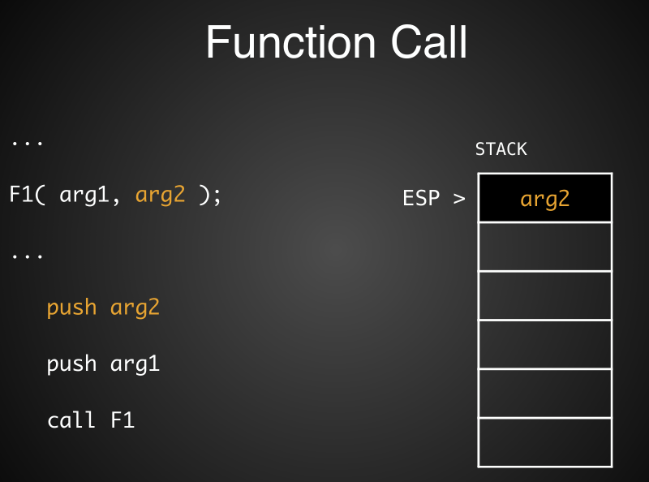
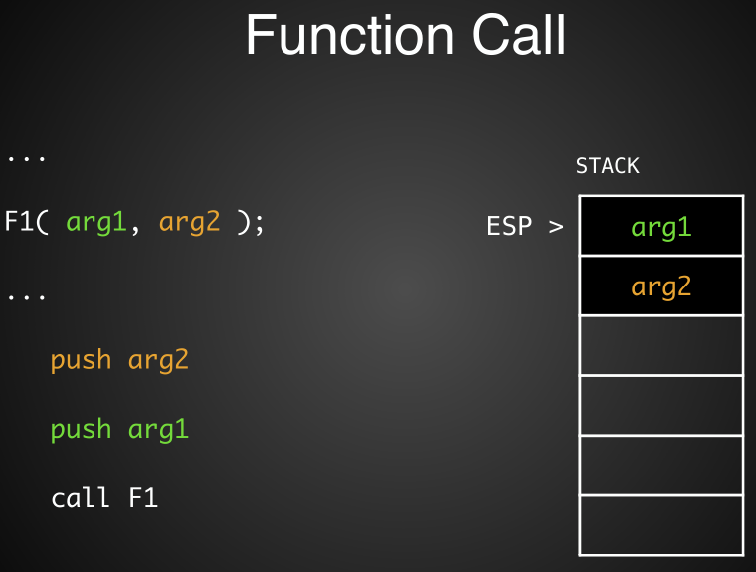
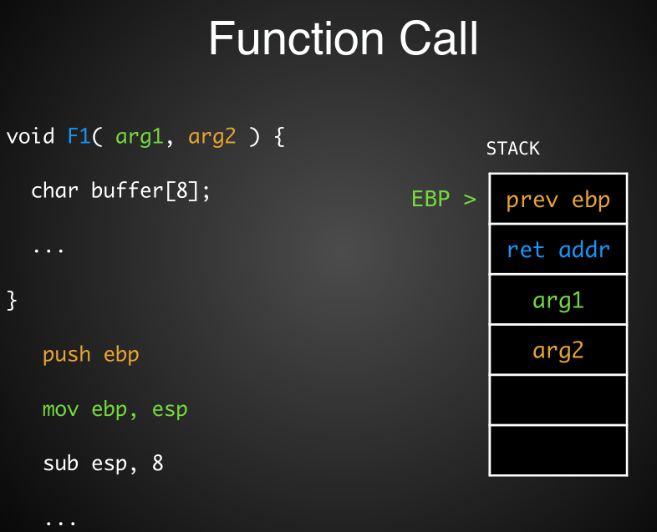
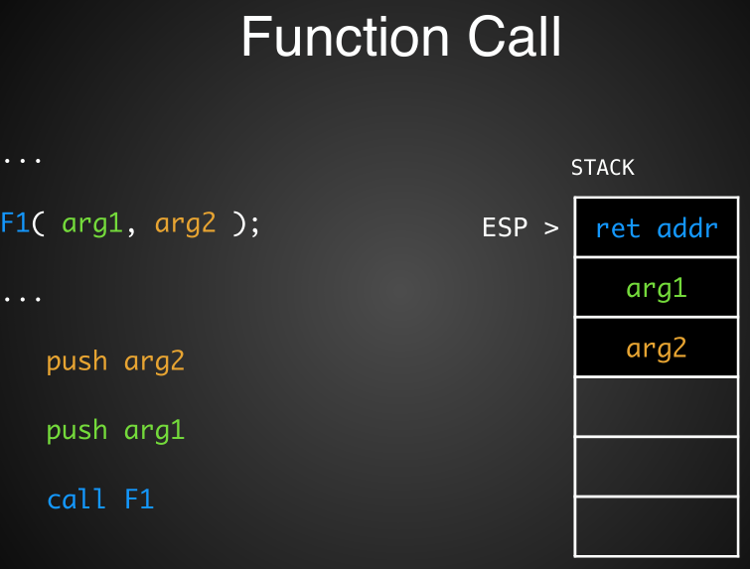
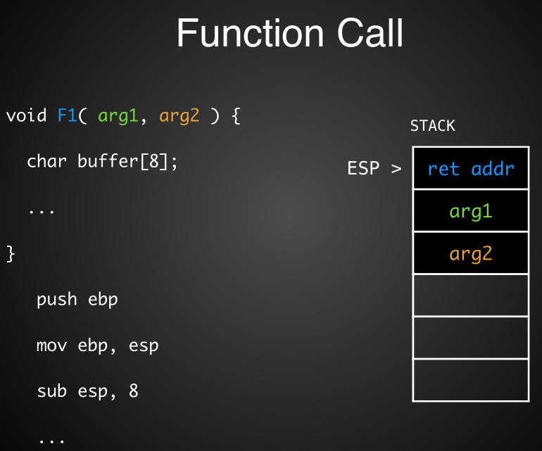
The stacks are continuous!

Slide 11
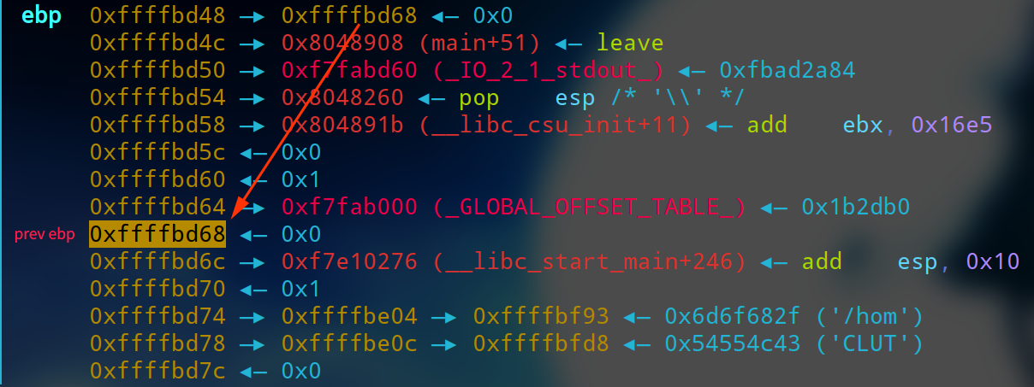
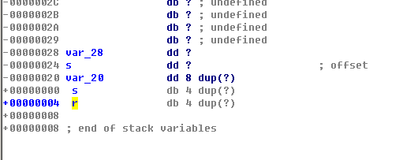
How the function return?
——Stack and frame
| var |
+-----+
|ebp |
+-----+
| ret |
+-----+

Slide 12
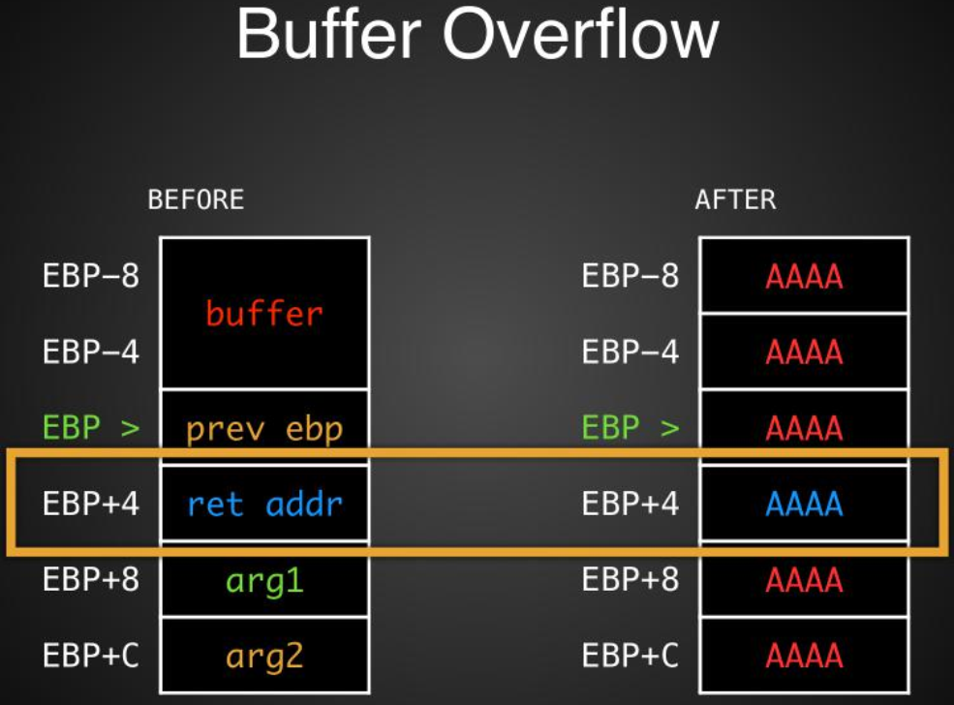
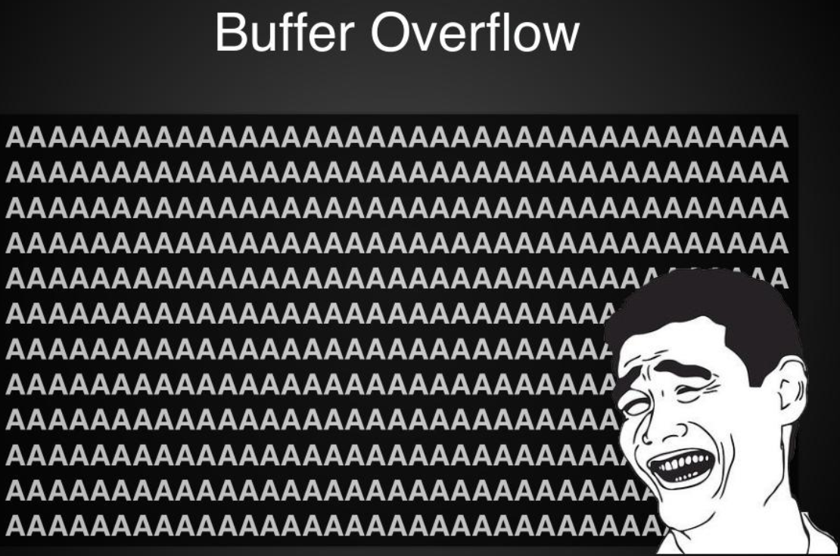
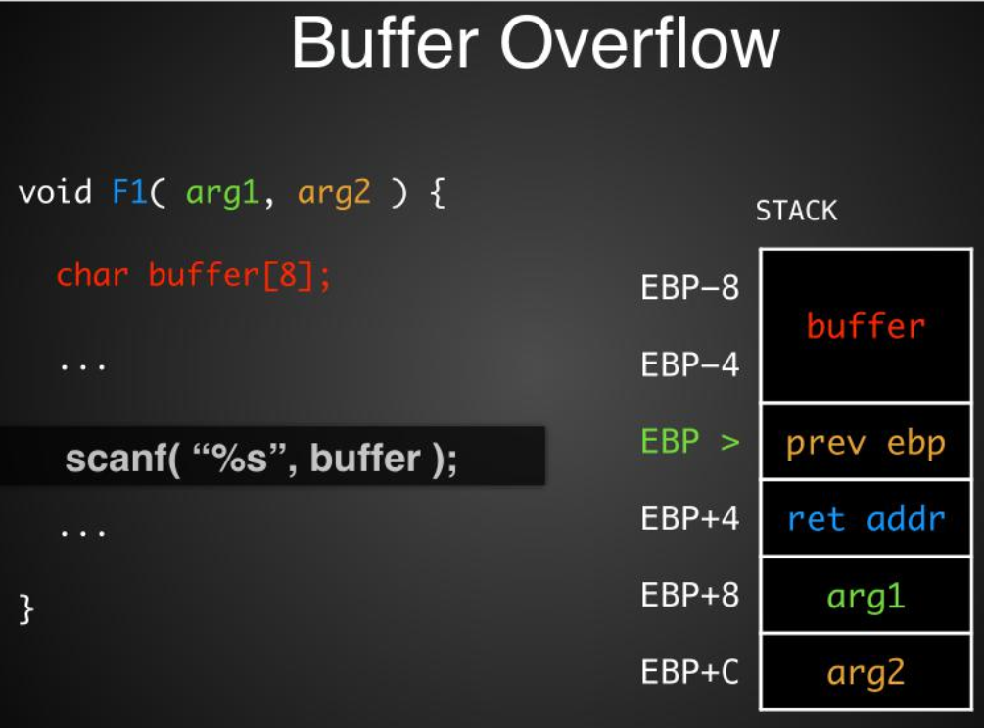
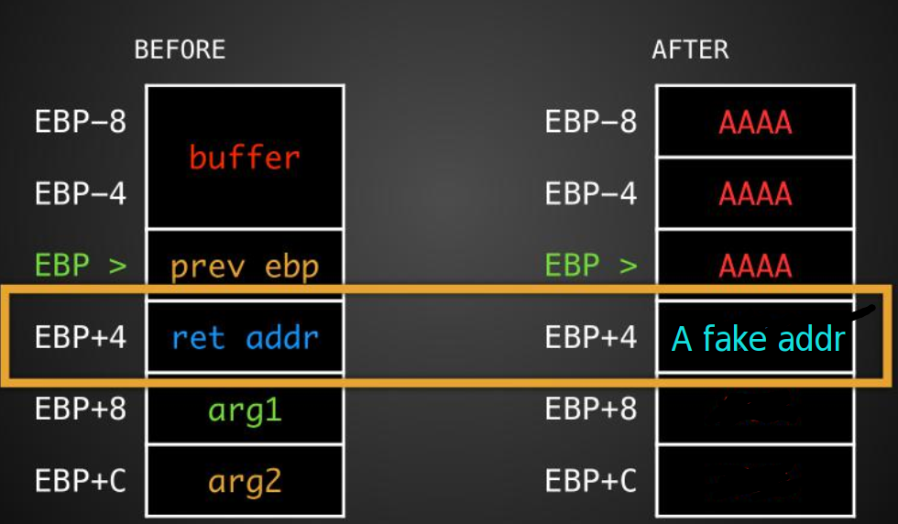
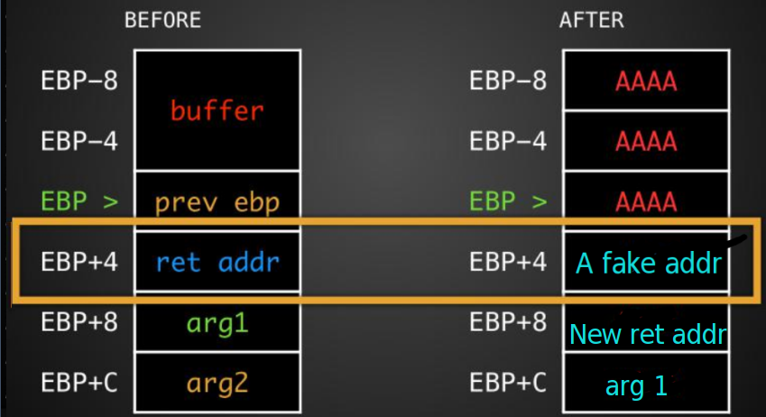
What is Stack overflow
| var |
+-----+
|ebp |
+-----+
| ret |
+-----+
Notes:
exp:jarvis oj level 0

Slide 13
字节序问题
大端序
  “正常的顺序” ： 234156 -> 0x392ac ->0x 00 03 92 ac
小端序
  计算机中将将高位字节放在后面
  234156 in mmory:
    ac 92 03 00
  'aaaaaaaaa' + '\xac' + '\x92' + '\x03' + '\x00'

Slide 14
Some examples:
$ pip install pwntools
$ checksec filename
python
  from pwn import *
  io = remote(“ip”, port) # 远程连接
  # io = process(“./filename”) # 本地调试
  elf = ELF(“./filename”)
  elf.symbols[“func_name”]
  io.send() / io.sendline()
  io.recv() / io.recvuntil()
  p32() ; p64()

Slide 15

Homework
学习GDB使用
尝试根据ida的反编译结果还原程序逻辑
Jarvis OJ level0
根据自己的理解，将本ppt的内容整理一遍，并完善本ppt释义
rop_rop_rop(选做)
要把level0 和 rop_rop_rop(选)的writeup(分析思路)和代码打包发送邮箱哦。

